Slide 1
.NET, and Service Gateways
Group members: Andre Tran, Priyanka Gangishetty,
Irena Mao, Wileen Chiu

Slide 2
In This Presentation
SOAP
.NET
Service Gateways
WebSphere

Slide 3
SOAP
Enables communication among web services
XML-based protocol for exchanging messages and Remote Procedure Calls (RPC)
Works on existing transport protocols, like HTTP and SMTP, instead of a new one
Makes use of application layer protocol as transport protocol

Slide 4
.NET Framework
Developed by Microsoft for use in Windows
Prefabricated infrastructure to develop desktop and Internet applications
Provides language interoperability

Slide 5
Architecture
Common Language Runtime
Language neutral platform for application development and execution
Act as virtual machine that run managed codes
Features: exception handling, memory management (garbage collection), security, interoperability
Written in high level language (Visual Basic .NET or C#), compiled into intermediate language which must be interpreted by Just-In-Time compiler

Slide 6
Architecture cont.
Class Library
contains foundation classes used to build applications
has a tree structure and each class inherits functionalities of the parent
.NET framework can be extended by creating custom classes

Slide 7
Architecture cont.
Windows Forms
provides ready to use interface elements such as:
windows, buttons, dialog boxes, data grids
includes a new version of the Graphics Device Interface (GDI)
responsible for representing graphical objects and transmitting them to output displays like monitors or printers

Slide 8
Architecture cont.
ASP .NET
provides support to build and run applications
prefabricated controls for HTML
Web Server runtime environment to dynamically generate HTML pages
services like data caching to speed up often downloaded documents and security to block malicious clients

Slide 9
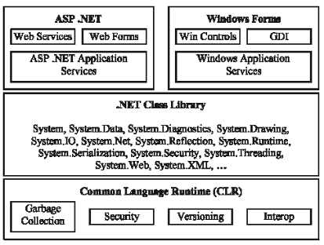

Slide 10
.NET Remoting
API for interprocess communication
Replaces DCOM which allowed clients to use remote computers as local objects
Unlike DCOM it is easier to configure and scale
“Pluggable” architecture makes it flexible

Slide 11
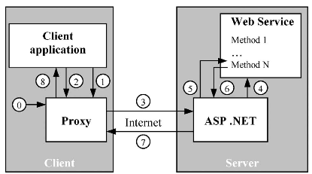
.NET Remoting cont.

Slide 12
.NET Remoting cont.
Supports three types of remote objects:
SingleCall, Client Activated, Singleton
Includes the following prebuilt channels:
TcpChannel: uses TCP/IP with proprietary binary protocol as transport layer
HttpChannel: text based channel that is not as fast or compact but can cross firewalls

Slide 13
.NET Remoting cont.
Channels can choose from the following prebuilt formatters:
Binary: serializes data into compact proprietary .NET format that can only be used by .NET applications
Extended Simple Object Access Protocol: uses proprietary logic to reproduce any .NET object, but compromises interoperability with non .NET frameworks

Slide 14
Service Gateways
Service Gateway is an Application Proxy service that should be required for ALL internet facing web sites and applications
Provides a single access point for multiple service providers for multiple consumers
Eliminates the need for many mediation modules between each consumer and service provider

Slide 15
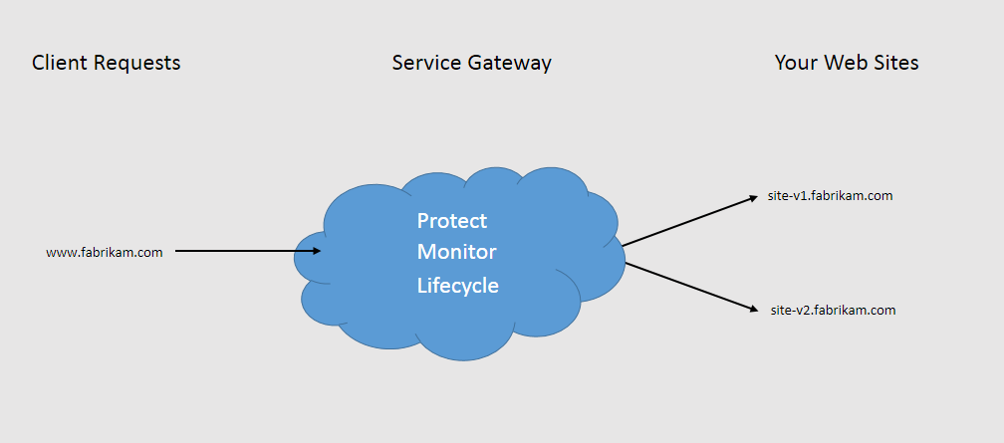
High level architecture of application using a Service Gateway

Slide 16
Roles of a Service Gateway
Protection-
Authentication and authorization
Prevents DoS and DDoS
Monitoring-
Prepares web logs for all traffic and reports common analytics
Provides features to connect to Excel/ BI tools to manually run reports
Life cycle management-
Enables user routing
Provides agility with the services

Slide 17
Types of SGs
Static SG
Services are fixed during development time and cannot be changed during runtime
Dynamic SG
Services can be changed dynamically
Service endpoints are delivered at runtime by a registry or database
Proxy SG
Its a dynamic SG
But service endpoints are held in built-in configurations

Slide 18
IBM’s WebSphere
software to enable dynamic, interconnected business processes, and deliver application infrastructures
application and integration software platform
includes entire middleware infrastructure

Slide 19
Core WebSphere Solutions
Application infrastructure
Connectivity, Integration and SOA
Mobile Development and Connectivity
Business Process Management
Portals
Mobile Management and Security

